Slide 1
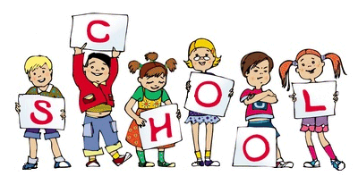
Our P1 and 2 memories
By Gracie and taylor

Slide 2
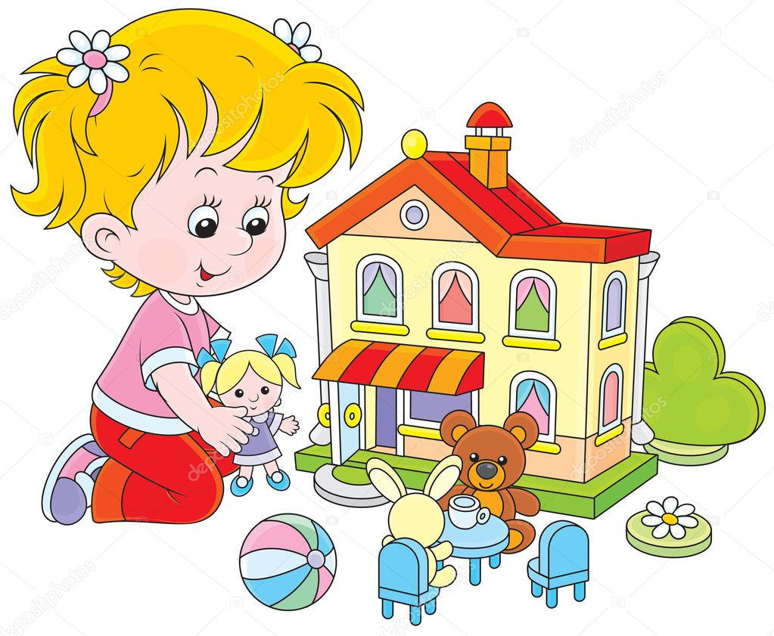
Gracie loved dressing up and playing in the little house

Slide 3
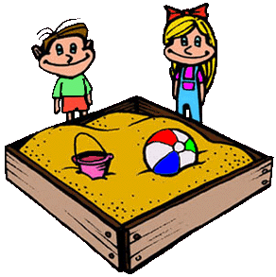
Taylor liked playing with the sand pit

Slide 4
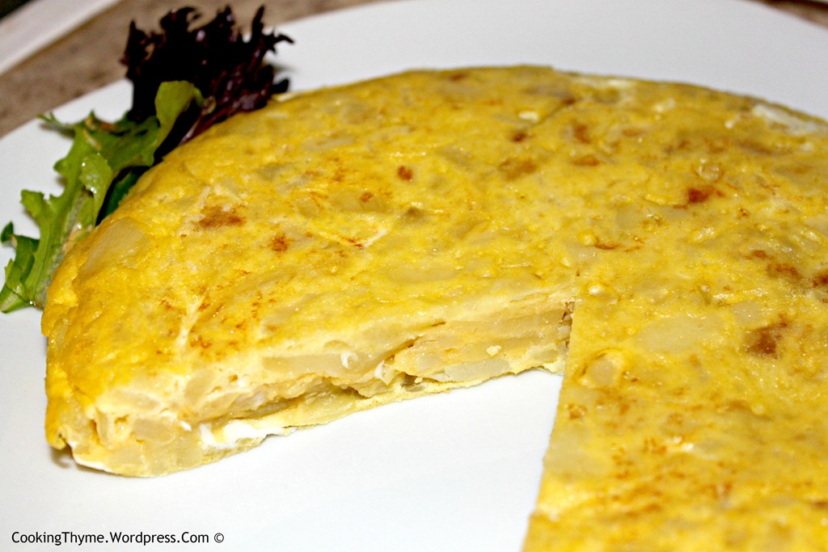
Mrs Beattie made yummy tortilla

Slide 5
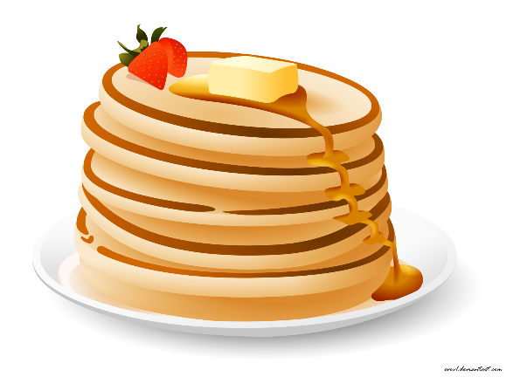
You also made delicious pancakes

Slide 6
Our favourite memories
My favourite memory was when we made iced biscuit Taylor
I liked busy bees Leah
I loved Mrs Beattie’s pancakes Matthew
I loved your tortilla Asher
I enjoyed our trip to streamvale farm Nancy
I enjoyed our trip to the forest Hannah t
I enjoyed making sandwiches Hannah c
I enjoyed playing the playmobil Jacob

Slide 7
Our favourite things about you
Kind
Helpful
Jolly
Bright
Happy
Caring
Loving
sharing

